Slide 1
Opportunities for Improved Partnerships with African Diaspora in Harnessing EO data for Sustainable Development
Henry N. N. Bulley BMCC, The City University of New York

Slide 2
Overview
CADFP fellowship visits to Ghana and Uganda in 2016 and 2019
Follow-up collaborative initiatives with Colleagues in Africa
AfriGEO side-event
Database of Diaspora & African Geospatial Scientists
Collaborative initiatives with colleagues in North America
Challenges and opportunities for African Diaspora collaboration to contribute to Agenda 2063 (Outer Space Technology)

Slide 3
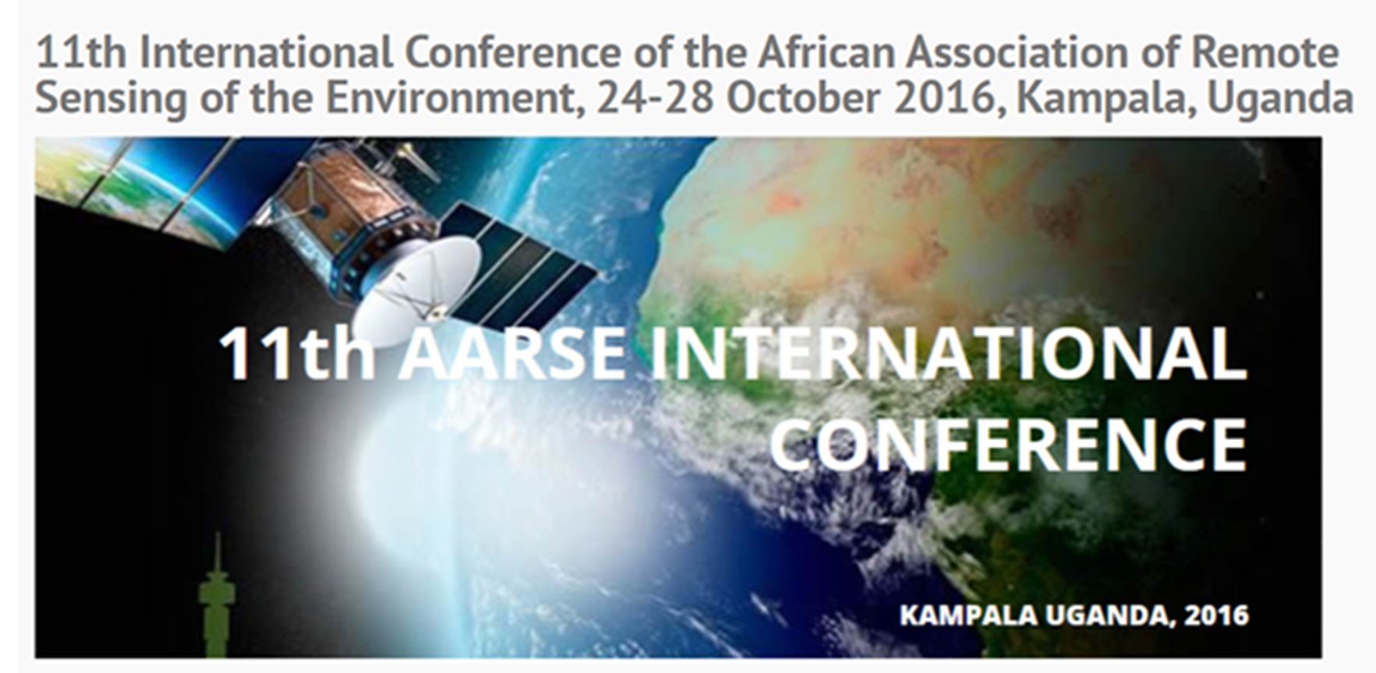
Introduction/Background
CADFP fellowship visits in 2016 (Uganda)
AASRE 2016 Conference Pre-Conference workshop: Landscape Ecology Applications to Assessing Land Use Dynamics and Ecosystem Services across Multiple Spatial and Temporal Scales
Conference Symposium: Integration of landscape ecology and geospatial technology for sustainable development of peri-urban areas in Africa

Slide 4
Collaborative Initiatives With Colleagues in Africa
CADFP fellowship visits in 2016 (Uganda)
AfriGEO side-event on Strengthening partnerships with African Diaspora on Earth Observations during the October 2017 GEO-XIV Plenary

Slide 5
Collaborative Initiatives With Colleagues in Africa
How do we collaborate with the international experience and know-how of African Diaspora in EO capacity building for African countries to:
Enhance Africa’s capability to use EO in decision-making processes for achieving continental and global agendas?
Boost the development of human capital, especially youth and young women, in basic and applied in Geospatial Science and Technology research?
Reach a coordinated EO data acquisition strategy?
Implement the African Space Policy and Strategy?
What then, is the Knowledge base of the African Diaspora?

Slide 6
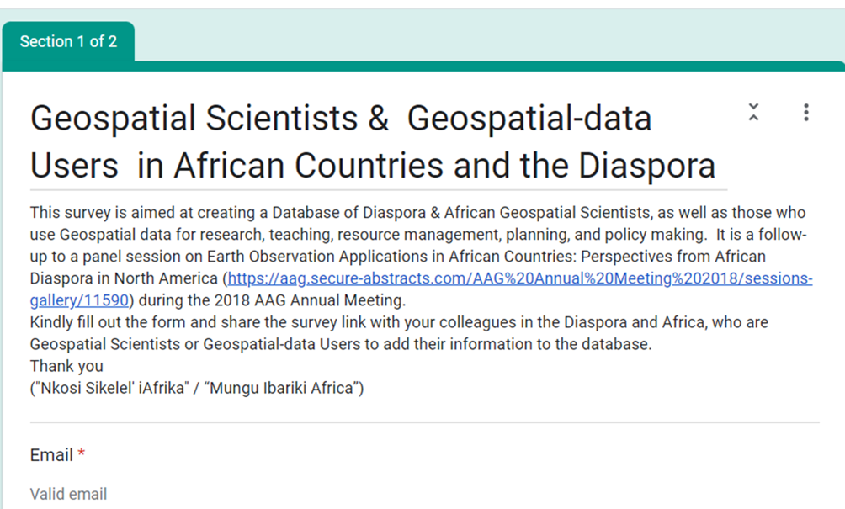
Survey of Earth Observation Capacity & Needs
Goal: Create a Database of Diaspora & African Geospatial Scientists, as well as those who use Geospatial data for research, teaching, resource management, planning, and policy making.
The ultimate goal is to create a database-driven App for Capacity building and research collaboration between Diaspora & African Geospatial Scientists, as well as those who use Geospatial data for research, teaching, resource management, planning, and policy making

Slide 8
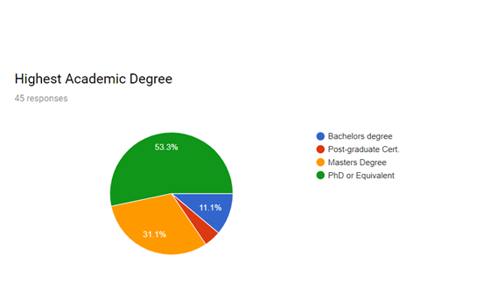
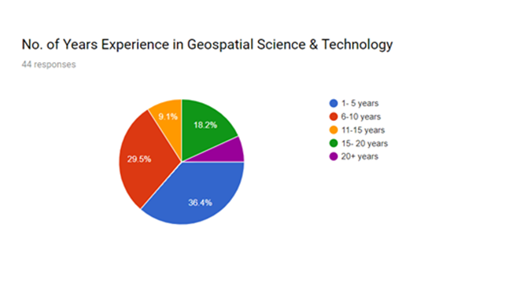
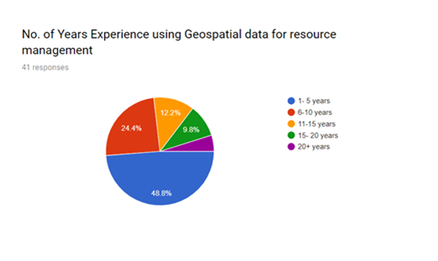
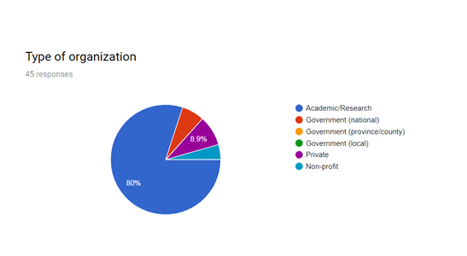
Survey Results

Slide 9
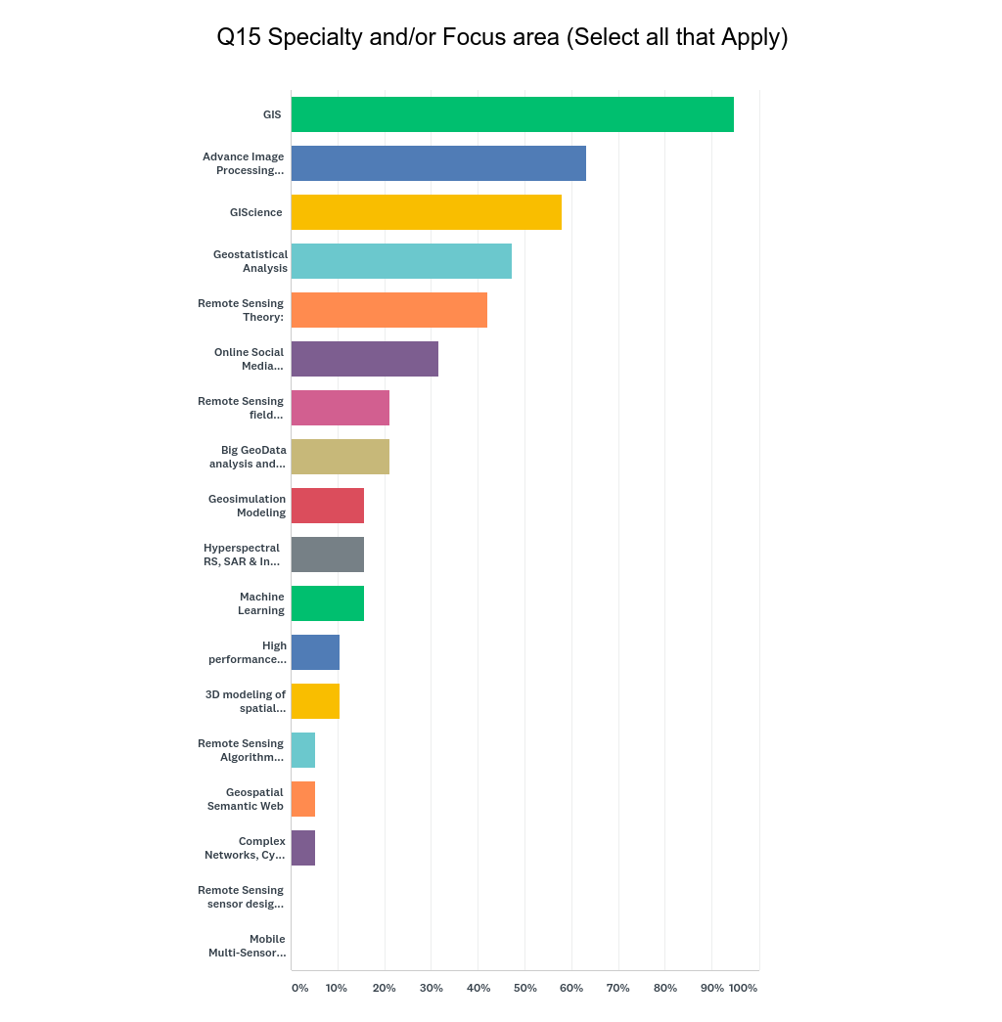
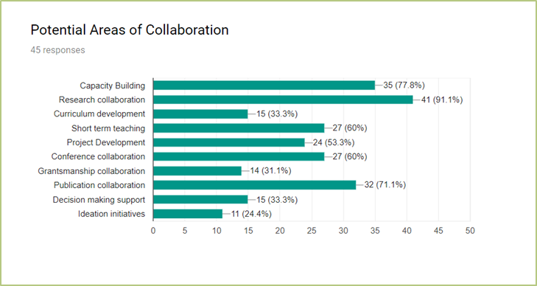
Intellectual Capital of African & Diaspora Partners
Need for collaboration:
Among native born Africans and African Americans born in the USA
Among Africans/African Americans and Non-African “Compatriots”

Slide 10
Challenges & Opportunities For Collaboration
African Diaspora Research Network (ADRN) was suggested by Paul Zeleza in 2013 as a way of promoting scholarly partnerships among the African Diaspora, but this is yet to be realized
Due to the subject-matter focus of most of Academic collaborations instead on problem-based approach that encourages cross-disciplinary and trans-disciplinary engagements.
Core of challenges facing the African Diaspora in North America
Initial shock and coming to terms with their new status in a society where their color/race plays a major role in navigating the power
Institutional barriers to access career boosting opportunities:
Employment flexibility, research and grant funding
Investment capital in a highly differentiated educational and career landscape

Slide 11
Challenges & Opportunities For Collaboration
With the African Union’s interest in harnessing the Diaspora expertise to facilitate the continent’s development, it is imperative to realize the idea of an African Diaspora Research Network (ADRN).
ADRN must comprise not only African Diaspora Academics, but includes graduate students of African background as well as providing a space of belonging to Africa Americans citizens in Academia.
ADRN may provide a much-needed forum for resilience in the tertiary educational system in North America and provide networking opportunities for disciplinary and transdisciplinary research and career mentoring with the empathy that “only” African Diasporas could appreciate.
Joint initiatives may also provide a means to access research and other collaborative grant opportunities needed to establish academics career and eventually link up with partners in African countries.

Slide 12
Challenges & Opportunities For Collaboration
CAUTION: For African Diaspora to “effectively and positively” impact the Africa Union’s goals as stated in the Agenda 2063, the Diaspora need to be mindful that programs do not erode the socio-cultural norms that have sustained Africans through the ages.
Opportunity: The advent of virtual meeting platforms in a post-COVID pandemic world have unleased unprecedented opportunities for African Diaspora seeking to actively contribute to higher teaching and research ventures in Africa, including co-developing research proposals and publications

Slide 13
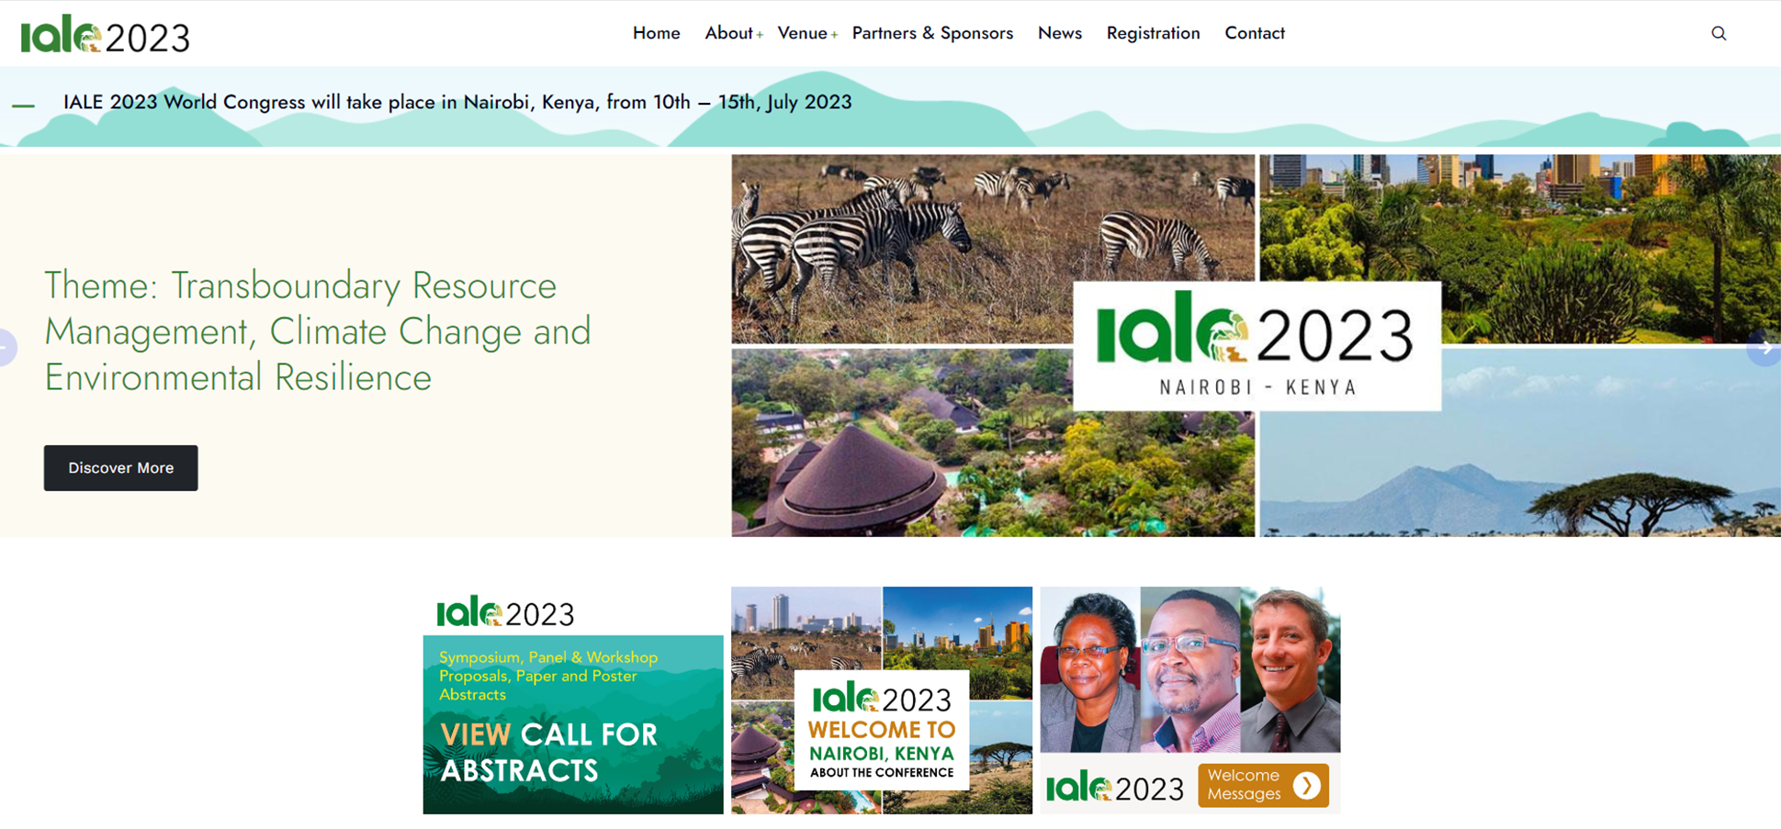
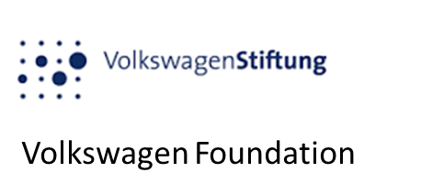
Acknowledgements
IALE 2023 World Congress will take place in Nairobi, Kenya, from 10th – 15th, July 2023

Slide 14
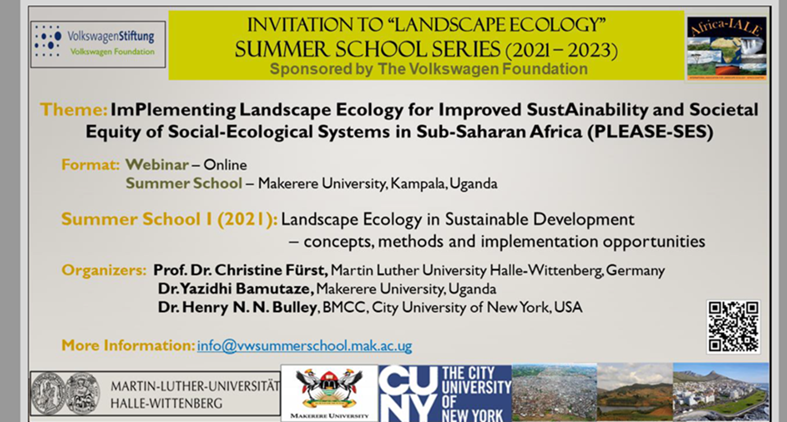
Collaborators, Stakeholders and Users

Slide 15
Collaborators, Stakeholders and Users
1. GEO BON – Microsoft: EBVs on the Cloud Submitted June 06, 2020 (NF)
Title: Leveraging Machine Learning (Azure) with Geospatial Analysis to Understand and Model Elephant Populations and their Ecosystem Interactions in West Africa – A case of Digya National Park- Ghana
PI: Amos Kabo-bah, University of Energy and Natural Resources, Ghana (CADFP Host, Ghana)
Co-PIs: Henry N. N. Bulley, BMCC, City University of New York, USA (CADFP, USA)
Mark Amo-Boateng, University of Energy and Natural Resources, Ghana
Benjamin K. Nyarko, University of Cape Coast, Ghana
Frank Muller-Karger, University of South Florida, USA
Christine Fürst, Martin Luther University Halle, Germany
2. U.S. Embassy in Ghana 2020 University Partnerships Initiative Grant _June 19, 2020 (NF) Title: Improving Ecotourism and Livelihoods of Fringe Communities through enhanced Ecosystem Services of Digya National Park in Ghana
PI: Amos Kabo-bah, University of Energy and Natural Resources, Ghana (CADFP Host, Ghana)
Co-PIs: Benjamin K. Nyarko, University of Cape Coast, Ghana
Co-PIs: Mr. James Ohemang-Agyei, University of Energy and Natural Resources, Ghana
Co-PIs: Mr. Modoc Awudu, Afram Plains Development Organization (APDO), Ghana
Co-PIs: Henry N. N. Bulley, BMCC, City University of New York, USA (CADFP, USA)
Co-PIs: Samuel Adu-Prah, Sam Houston State University, Texas, USA (CADFP, USA)
3. Manuscript - Bulley, Henry N.N., et al.
Title - Geospatial technology and landscape ecology perspectives in conservation planning efforts for mitigating disturbance regimes in the Global South
Henry N. N. Bulley, BMCC, City University of New York, New York, USA (CADFP, USA)
Oludunsin T. Arodudu, Maynooth University, Maynooth, Ireland
Esther A. Obonyo, Penn State University, State College, USA (CADFP, USA)
Aniko Polo-Akpisso, Université de Lomé, BP 1515, Lomé, Togo
Esther S. Ibrahim, Geography Department, Humboldt-Universität zu Berlin, Unter den Linden 6, 10099 Berlin, Germany
Yazidhi Bamutaze, Makerere University, Uganda (CADFP Host, Uganda)

Slide 16
Collaboration Among African Diaspora in USA
In one such collaboration, we may made concerted efforts to commit to biweekly meeting of three partners from Earth Observation and Geospatial Science, Health Geography, and Building Construction Engineering. Presenting our research work in a way that elicits ideas for collaborative venture was daunting initially, but we eventually learned enough from each other to engage in partnerships.
One partner (Dr. Raymond Tutu) is currently my CoPI on the USA funded portion of the aforementioned Belmont Forum Collaborative Research award titled, Developing REsilient African cities and their urban environMent facing the pro-vision of essential urban SDGs (DREAMS).
The other partner (Dr. Esther A. Obonyo, Penn State University) is a coauthor on the aforementioned manuscript, Geospatial technology and landscape ecology perspectives in conservation planning efforts for mitigating disturbance regimes in the Global South. Her insights in the process of building construction was very insightful in broadening my perspectives on impact on urban growth and/or sprawl on the environment, in this case the biodiversity of peri-urban areas surrounding Nairobi.

Slide 17
Thank you
Questions?

